Slide 1
SAP Data migration
AI solution to check data quality

Slide 2
📌 Context
During data migration from SAP to a new system, the receiving APIs (Kraken APIs) enforce strict data quality checks and raise exceptions for bad or incomplete data, such as:
Invalid mobile numbers
Improper email formats
Names with special characters or digits
Blank required fields

Slide 3
❗ Problem statement
Manually identifying and fixing these issues after API rejection causes:
⏱️ Delays in the migration process
🔁 Rework cycles between source and validation teams
📉 Poor migration success rates
🚫 Bottlenecks in downstream automation

Slide 4
Objective
To build a predictive and proactive validation mechanism that:
🚨 Flags potential data quality issues before API calls
📈 Reduces failure rates and manual intervention
🧠 Uses scalable techniques like rules, ML, and LLMs
🔄 Learns and adapts as more data becomes available

Slide 5
Approach 1: 📘 Rule-Based Engine (Deterministic)
Approach: Implement a lightweight Python-based engine that uses predefined rules
to detect data quality issues (e.g., blank fields, invalid mobile numbers,
or improper email formats) directly from the Excel input file.
✅ Easy to set up, understand, and maintain
🛠 Rules: Mobile = 11 digits, email format check, no blanks
📂 Automatically updates the EXCEPTION column in excel file

Slide 6
Approach 2: 🤖 Machine Learning Classifier (Supervised Learning)
Approach: A baseline ML model (Random Forest / SGD Classifier) was trained on historical SAP records with exception labels to learn data quality patterns and predict exceptions on new records.
🧠 Learns from existing labeled exception data
🔍 Predicts probable exception types before calling Kraken APIs
📉 Improves over time as more data is added (retraining or online learning)

Slide 7
Approach 3: 🧠 LLM-Based Validation (Groq)
Approach: Use a large language model to validate customer data dynamically without hardcoding rules.
🔹 How it works:
Cleaned customer data is passed row-by-row into an LLM (Groq)
LLM uses a prompt containing all validation rules
It returns a structured result:
"VALID"
or errors like "LAST_NAME_BLANK, INVALID_EMAIL_FORMAT"
Result is saved back into Excel under an EXCEPTION column

Slide 8
Comparison
Feature / Approach | Rule-Based Engine | ML Classifier Model | LLM-Based (Qwen/Groq)
Setup Complexity | ✅ Simple if rules are clear | ⚠️ Medium (feature engineering, labels) | ⚠️ Easy logic via prompt, needs tuning
Adaptability to Change | ❌ Manual updates to code | ⚠️ Needs retraining | ✅ Just update the prompt
Scalability | ⚠️ Harder with many rules | ✅ Scales with data | ✅ Scales well via prompt logic
Accuracy (Structured) | ✅ High if rules are exact | ✅ Good after training | ✅ High for defined prompts
Explainability | ✅ Very clear | ⚠️ Medium (model insight) | ✅ Clear, with language-based errors
Real-time Prediction | ✅ Yes | ✅ Yes | ⚠️ Slightly slower
Maintenance | ⚠️ Frequent code changes | ⚠️ Retraining needed | ✅ Prompt-only changes
Cost | ✅ Very low | ⚠️ Moderate (compute for training) | ⚠️ Free for now (Qwen), but LLM tokens may cost later
TCO (Total Cost of Ownership) | ✅ Lowest | ⚠️ Medium | ⚠️ Low today; may increase with scale

Slide 9
Cost Comparison between 3 Approaches
Approach | Tech Stack Used | Infra Needed | Per-Use Cost | Scaling Cost | Time to Process (6K rows) | Suitable For
Rule-Based | Python (pandas, re, openpyxl) | Local CPU | Free | Free | Seconds–few mins | Deterministic validations (blank fields, regex, length checks)
ML (Classical) | Python (pandas, re, openpyxl) Random Forest (scikit-learn ) | Local CPU or small cloud VM | Free (local) / Low (cloud) | Low (batch jobs) | Few mins for 6K rows | Pattern detection, anomaly detection, probabilistic classification
LLM-Based | Python (pandas, re, openpyxl) Groq (LLaMA/Qwen) | Groq API (GPU infra) | Medium | Medium–High (depends on rows * tokens) | 10–20 min for 6K rows (rate-limits apply) | Fuzzy rules, reasoning, context-based validation

Slide 10
🧾 Cost & Performance Comparison Table (w/ Sample Pricing)
Option | Model / Provider | Pricing (as of Aug 2025) | Est. Cost per 1K Rows | Speed (1K rows) | Rate Limit | Infra Required | Notes
🆓 Free Public LLM (API) | Groq + Mixtral / LLaMA 3 via Groq API | Free (limited key) | $0 | ⏱️ ~10–15 min | ✅ ~1000 req/min | ❌ | Free but rate-limited and can fail over 1K rows
💵 OpenAI GPT-4 Turbo | OpenAI API | $0.01 / 1K tokens (input)$0.03 / 1K tokens (output) | ~$1–$1.5 / 1K rows | ⚡ 5–10 min | ✅ High (based on quota) | ❌ | High reliability, global support
💵 Anthropic Claude 3 | Anthropic API | $0.008 / 1K tokens (Haiku)$0.03 / 1K tokens (Sonnet) | ~$0.7–$1.2 / 1K rows | ⚡ Fast | ✅ Yes | ❌ | Haiku is cheaper, great for validation logic
🧪 Together.ai | LLaMA-3, Qwen, Mistral | Free trial or Pay-as-you-go: ~$0.25–$0.50 / 1M tokens | ~$0.2–$0.3 / 1K rows | ⚡ Fast | ✅ Higher quota than Groq | ❌ | Qwen 1.5 and LLaMA-3 available
💻 HuggingFace Inference Endpoint | LLaMA 2, Mistral, Falcon | $0.06–$0.12 / minute (basic endpoint) | ~$0.5–$1.0 / 1K rows | ⚡ 3–8 min | ✅ (via quota) | ❌ | Better suited for custom fine-tuned models
🖥️ Self-hosted (Local / GPU VM) | Ollama, vLLM, LMDeploy | Free (after setup) | ~$0.10 / 1K rows (infra only) | ⚡⚡ Fast | 🚫 Unlimited | ✅ Yes (e.g., 1 x A10 GPU) | Best for large scale or recurring jobs
🧠 RAG + Lightweight LLM | Any + Vector DB | Open Source + ~$0.05 API (if used) | ~$0.05 / 1K rows | ⚡ Fast (uses search + LLM) | ✅ Flexible | Optional | Very efficient for repeatable validation use cases

Slide 11
📌 Recommendations with Pricing
Use Case | Recommended Approach | Cost Range | Notes
✅ Prototyping (<1K rows) | Free Groq API or Ollama | Free | Use Qwen/Mistral, skip cost
🚀 6K+ production records | Paid OpenAI GPT-4 Turbo or Together.ai (Qwen) | $4–$9 | Use batching + parallelism
💰 Cost-efficient batch jobs | Claude 3 Haiku or Together.ai Qwen | $1–$3 | High-speed + better quota than Groq
🧠 Offline + Rule-Based | Local Qwen / RAG + small LLM | Free–$0.50 | Embed rules, reduce model load
🏢 Long-term / recurring jobs | Self-hosted LLaMA or Mistral on GPU VM | ~$0.5/hr | One-time setup, no per-call cost

Slide 12
💡 Tip: Time-to-Process Estimation
Batch Size | Time (Groq API) | Time (GPT-4 API) | Time (Self-hosted)
1,000 rows | ~10–15 min | ~5–8 min | ~3–5 min
6,000 rows | ~60–90 min | ~30–40 min | ~20–30 min

Slide 13
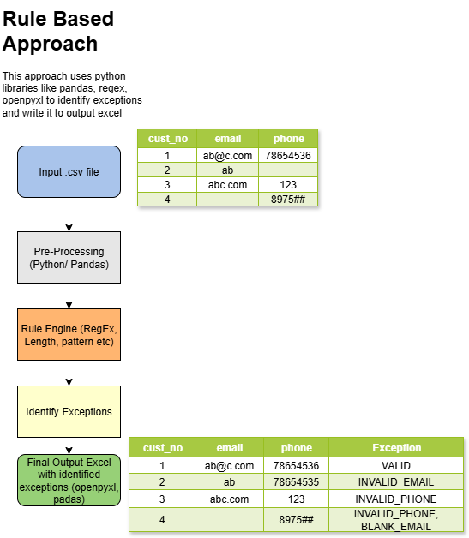

Slide 14
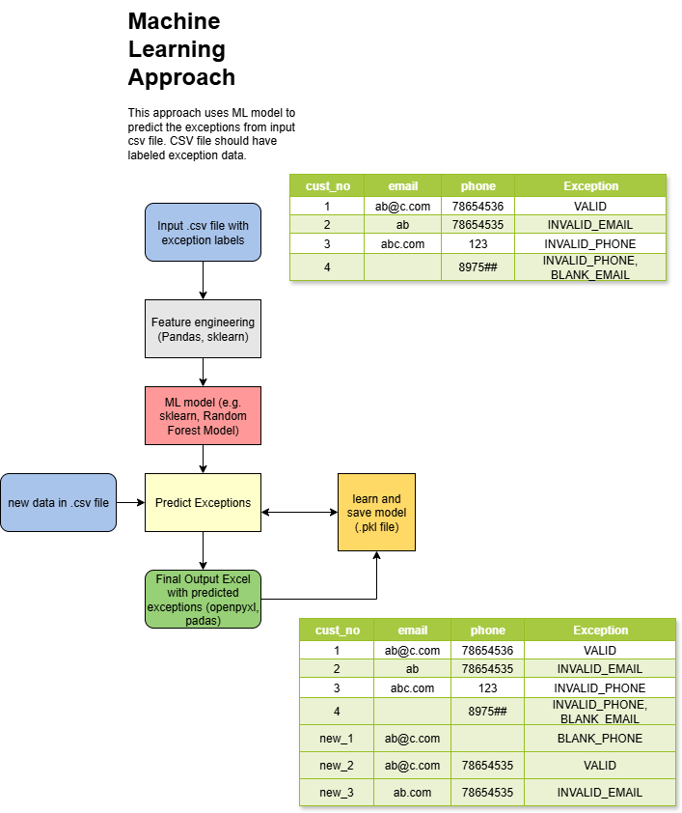

Slide 15
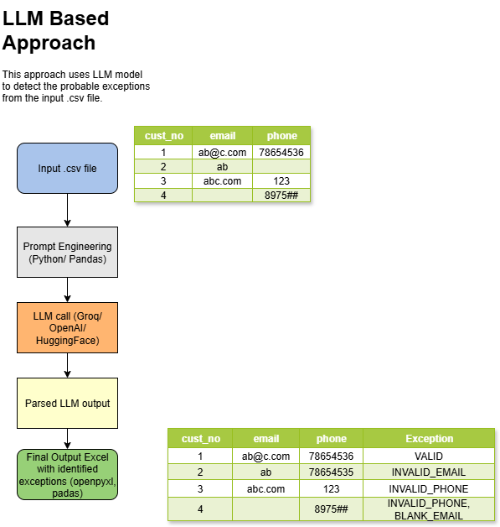

Slide 16
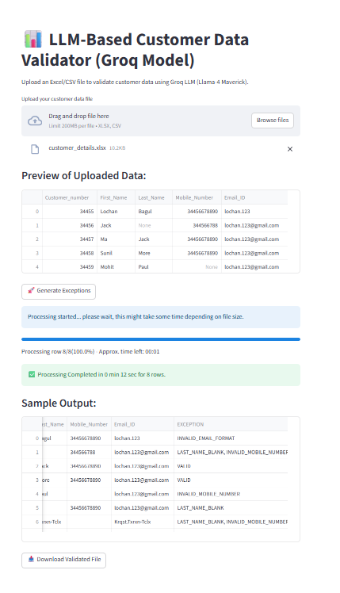
UI Design using Streamlit

Slide 17

Thank You

